Slide 1
STABILITY ASSESSMENT OF MAN-MADE SLOPES
A CASE STUDY IN YEN BAI
Alan Snow, Jason Besendorfer
Group 3

Slide 2
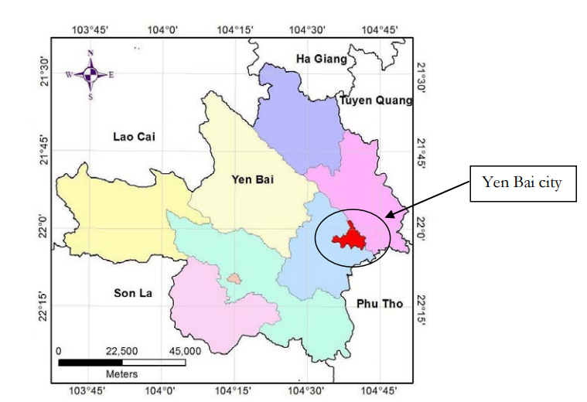
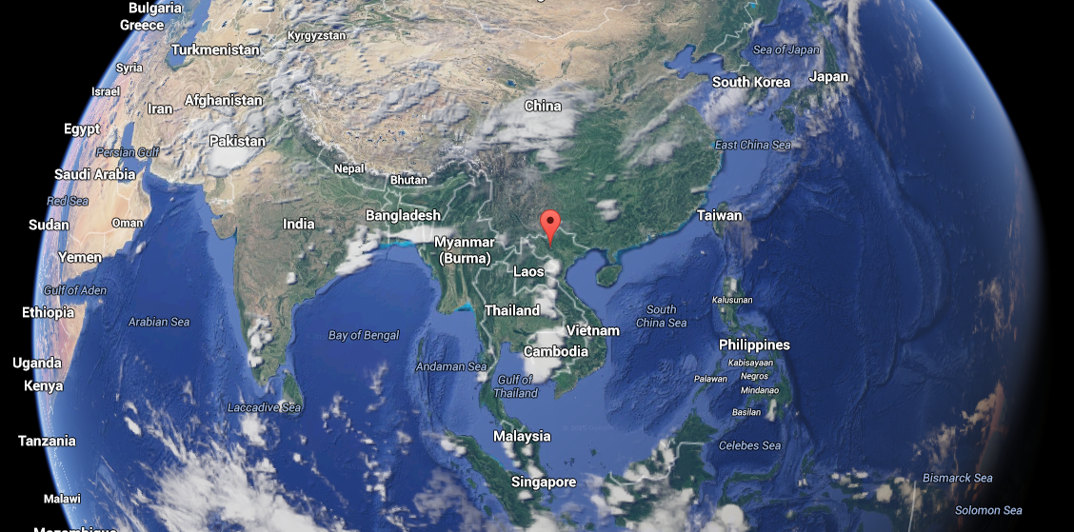
Yen Bai

Slide 3
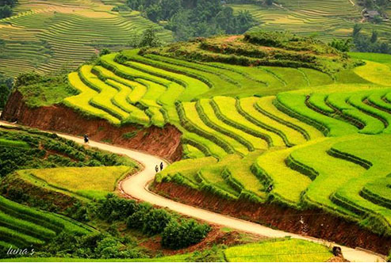
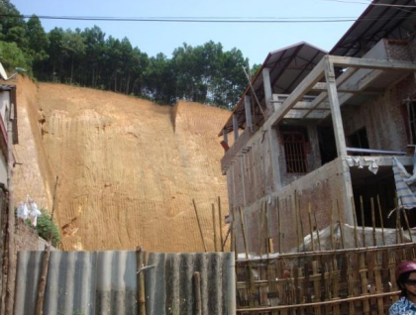
Urbanization

Slide 4
Slope Failure
Dissipation of pore pressure
Unusually high rainfall
Increase weight and decrease effective stress
Weathering
Decrease strength

Slide 5
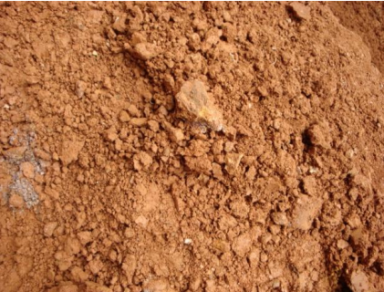
Weathering
Weathering Types
Physical
Frost
Thermal Expansion
Abrasion
Chemical
Carbonic Acid
Biological
Animal Burrowing
Growing Roots

Slide 6
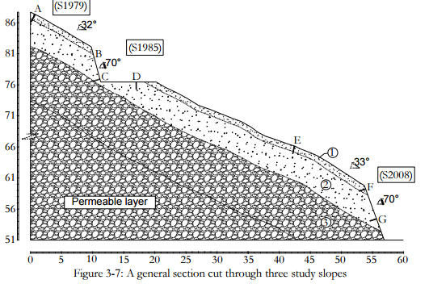
Analysis: Cross Section

Slide 7
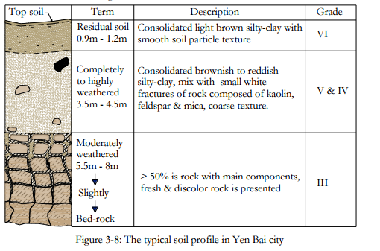
Analysis: Soil Types

Slide 8
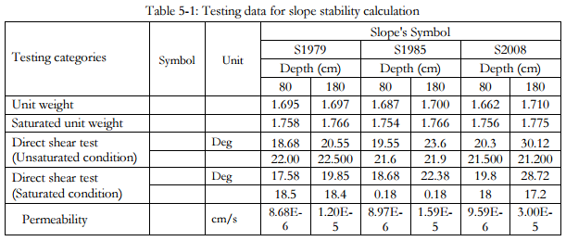
Analysis: Soil Data

Slide 9
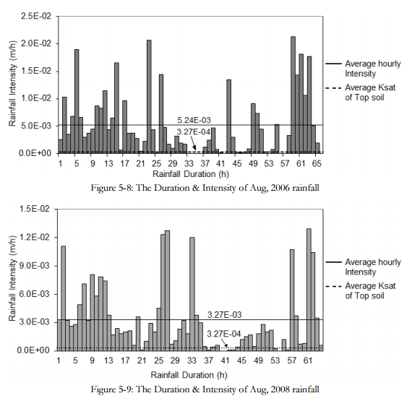
Analysis: Rain Data

Slide 10
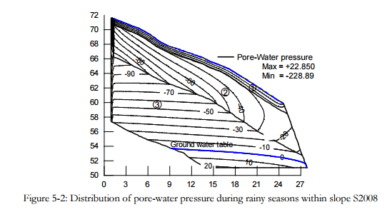
Analysis: SEEP/W

Slide 11
Analysis: SLOPE/W
They created stability models using Bishop method in the SLOPE/W program using inputs from SEEP/W model results.

Slide 12
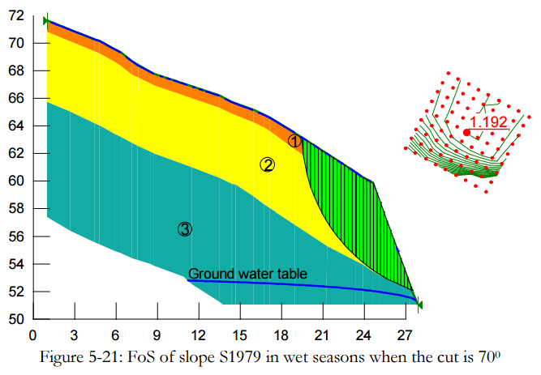
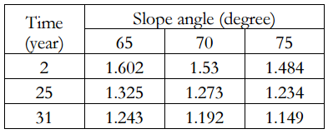
Results
Factor of Safety

Slide 13
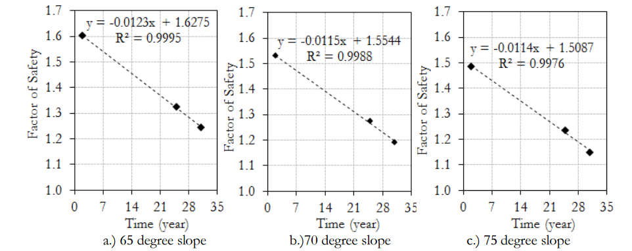
Results
Estimated Slope Life

Slide 14
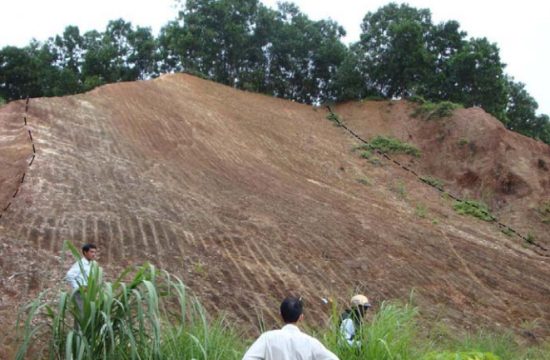
Slope Improvements
Excavate Weathered Soil

Slide 15
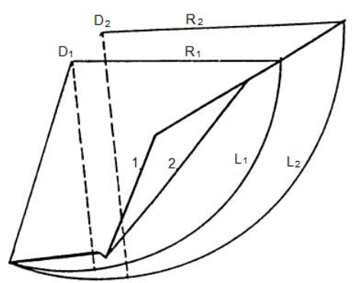
Slope Improvements
Flaten Slope

Slide 16
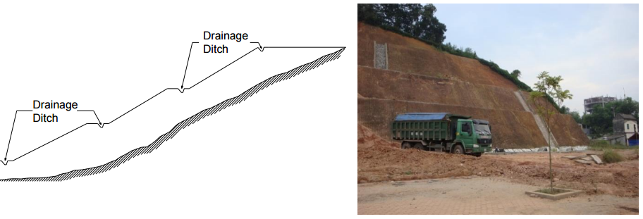
Slope Improvements
Benching

Slide 17
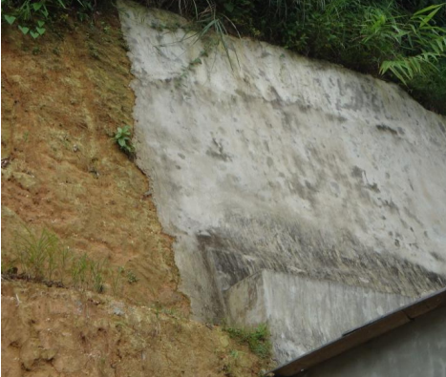
Slope Improvements
Shotcrete

Slide 18
Conclusion
For man-made slopes in tropical regions with a strong weathering process to be stable, mitigation steps are required!

Slide 19
References
Abramson, L. W. (Ed.). (2002). Slope stability and stabilization methods. John Wiley & Sons.
Alkema, D., & Hack, H. R. G. K. (2011). STABILITY ASSESSMENT OF MAN-MADE SLOPES A CASE STUDY IN YEN BAI.http://www.itc.nl/library/papers_2011/msc/aes/tran.pdf
Krahn, J. (2004a). Seepage modeling with SEEP/W: An engineering methodology. GEO-SLOPE International Ltd. Calgary, Alberta, Canada.
Krahn, J. (2004b). Stability modeling with Slope/W. Geo-Slope/W International LTD.

